Slide 1
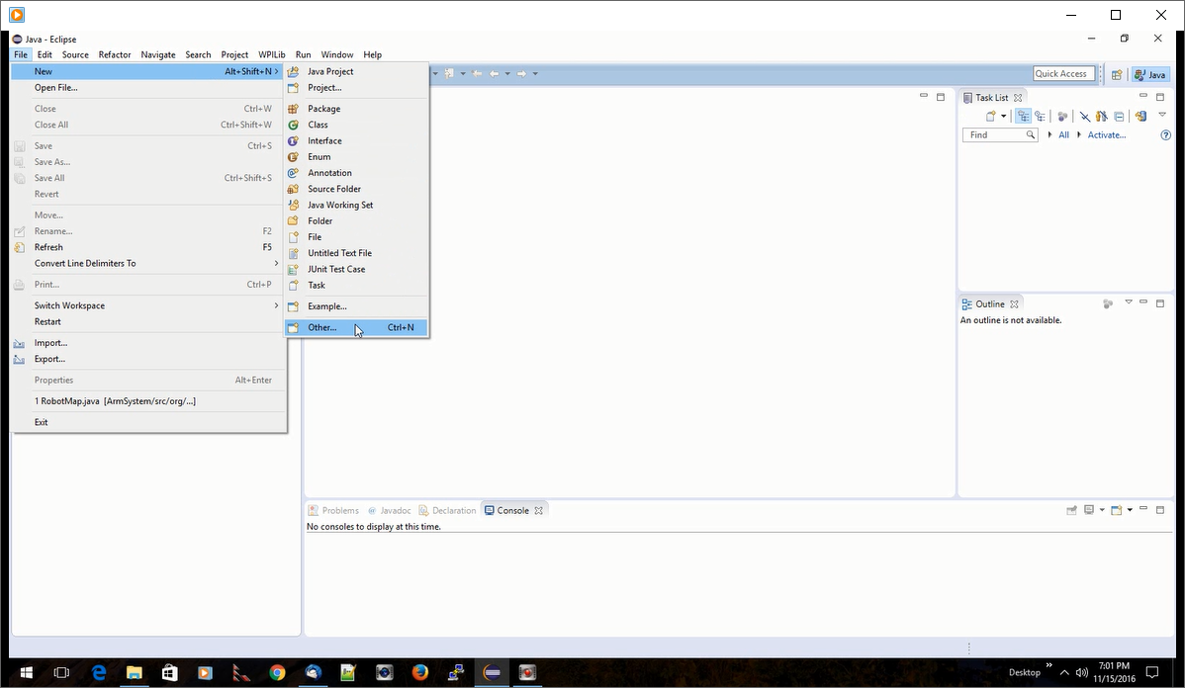
Eclipse with wpilib plugin
To create a FRC robot project
File>New>Other…

Slide 2
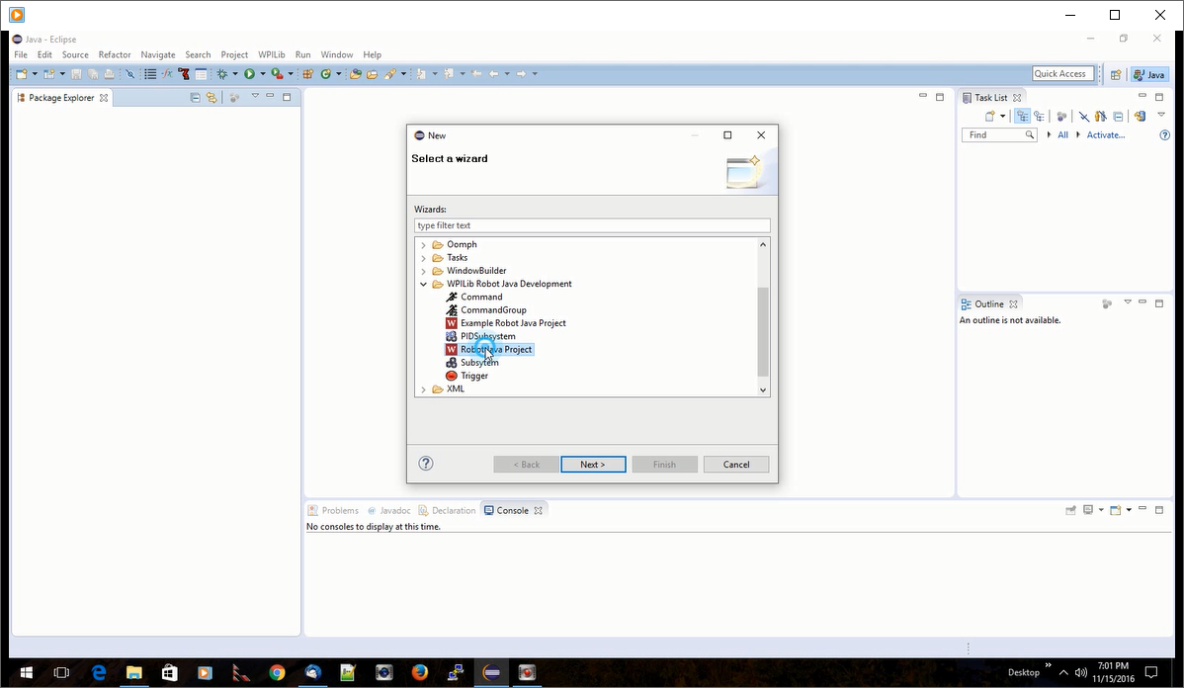
WPILib Robot Java Development
Robot Java Project<Next>
Note: Example Robot Java Project will lead to a list of sample robot projects available for your reading pleasure… We used the Vision samples last year to get the camera working for targeting.

Slide 3
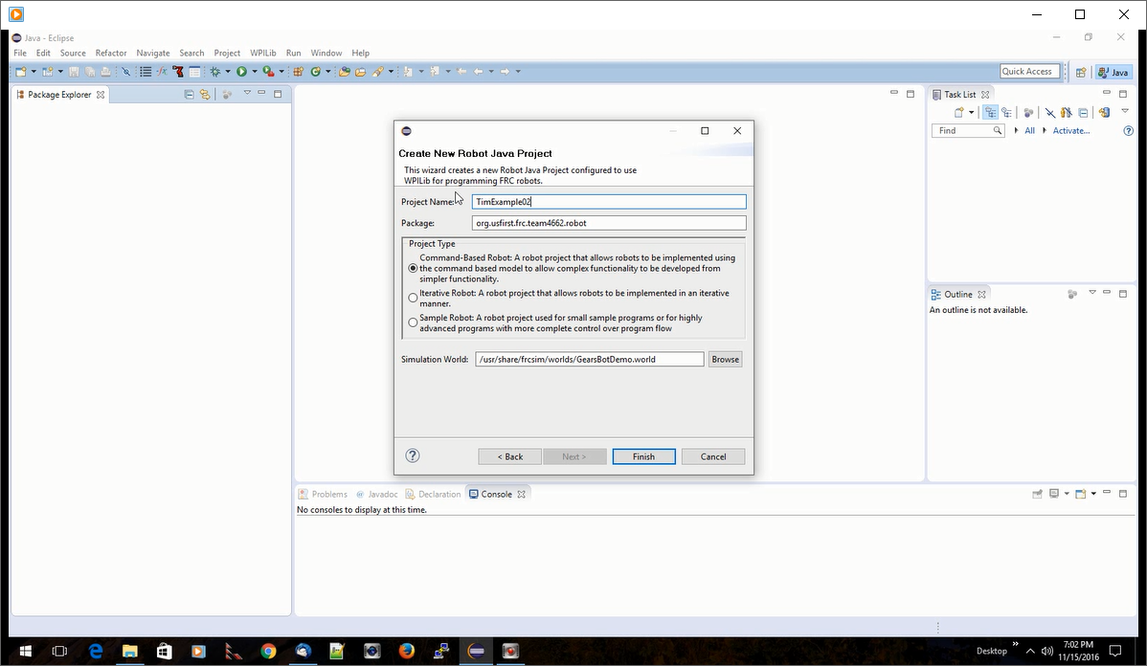
Fill in project name and the type of robot code template to be used.
We’ve been using Command Based structure.
Iterative and Sample might be used for simple learning exercises. However, if we stick to Command Based, any code built in prototypes could be copied directly into the full robot project.

Slide 4
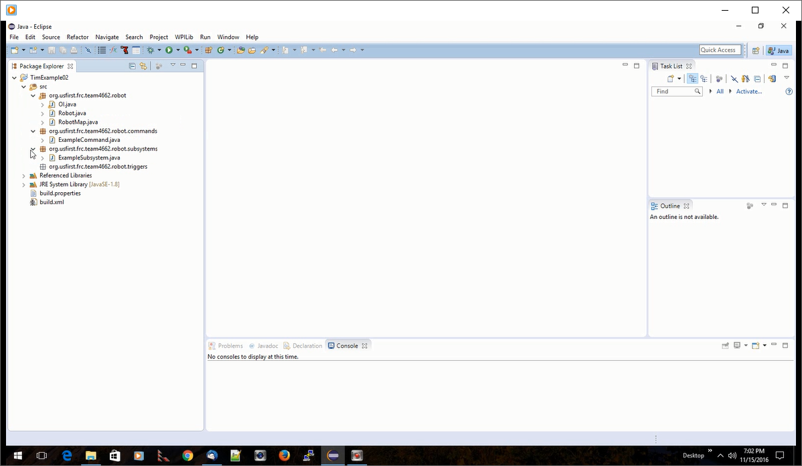
The base code structure will be generated, including all the standard classes we’ve seen from previous examples.

Slide 5
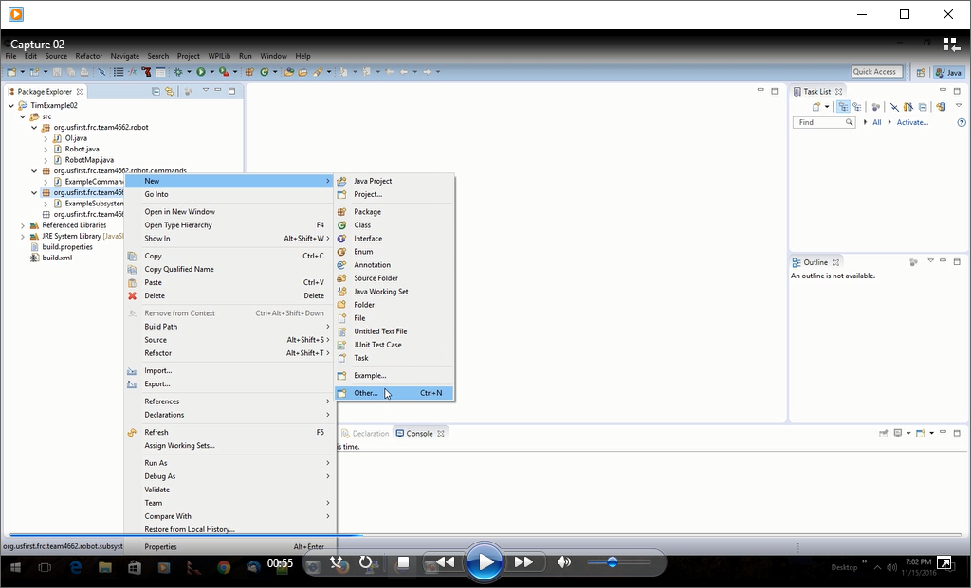
Right click on the Subsystem Package level
New>other<select>
This is the general pattern to add new classes within packages, just like we used in Hello World.
The difference is that we’re going to use WPILib template java classes.

Slide 6
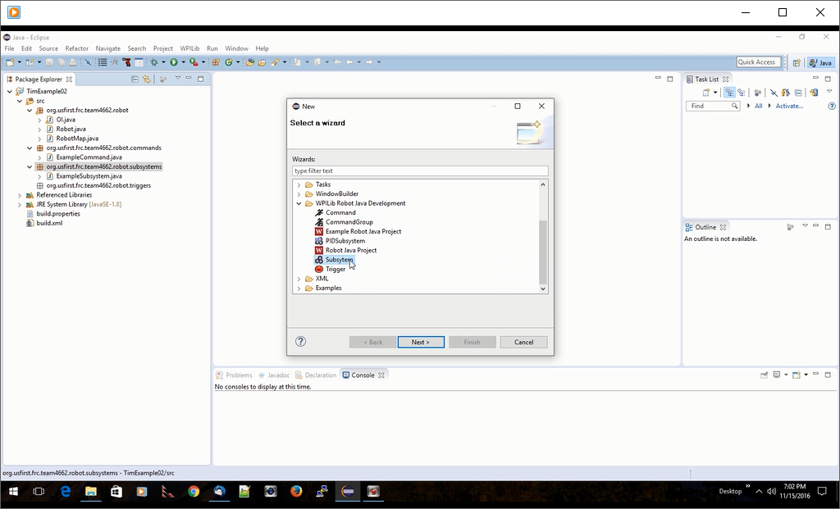
We’re in the Subsystem Package, creating a new Subsystem.

Slide 7
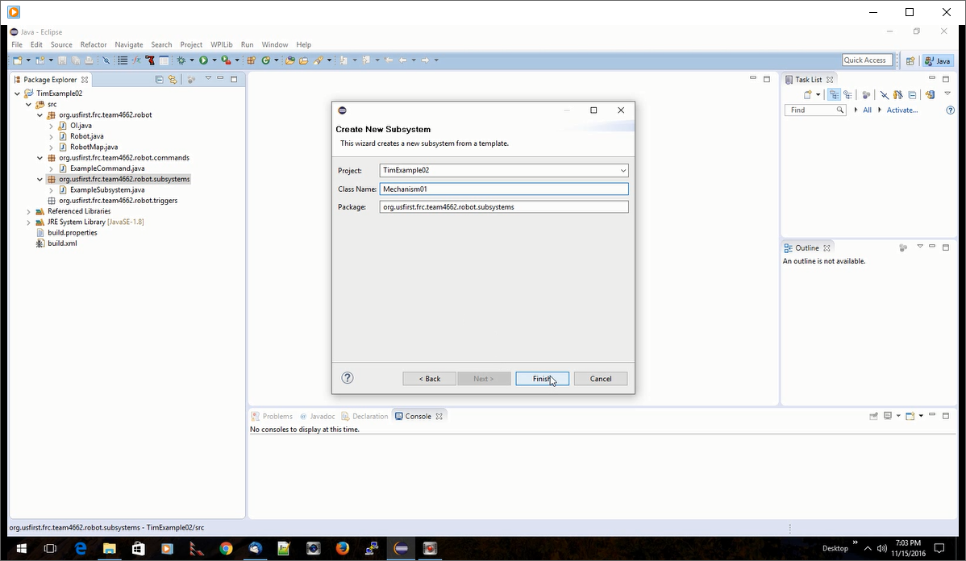
A dialog box pops up asking for a name.
Give it a meaningful name and press <next>

Slide 8
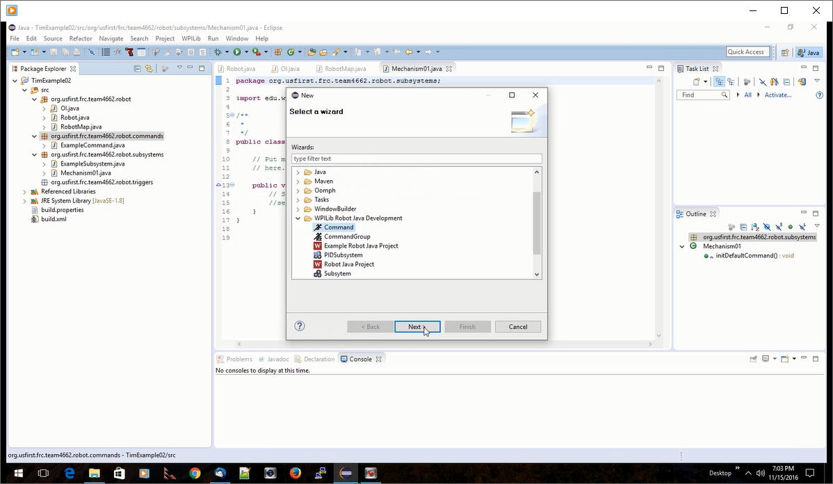
Same process under the Command package for a new Command.

Slide 9
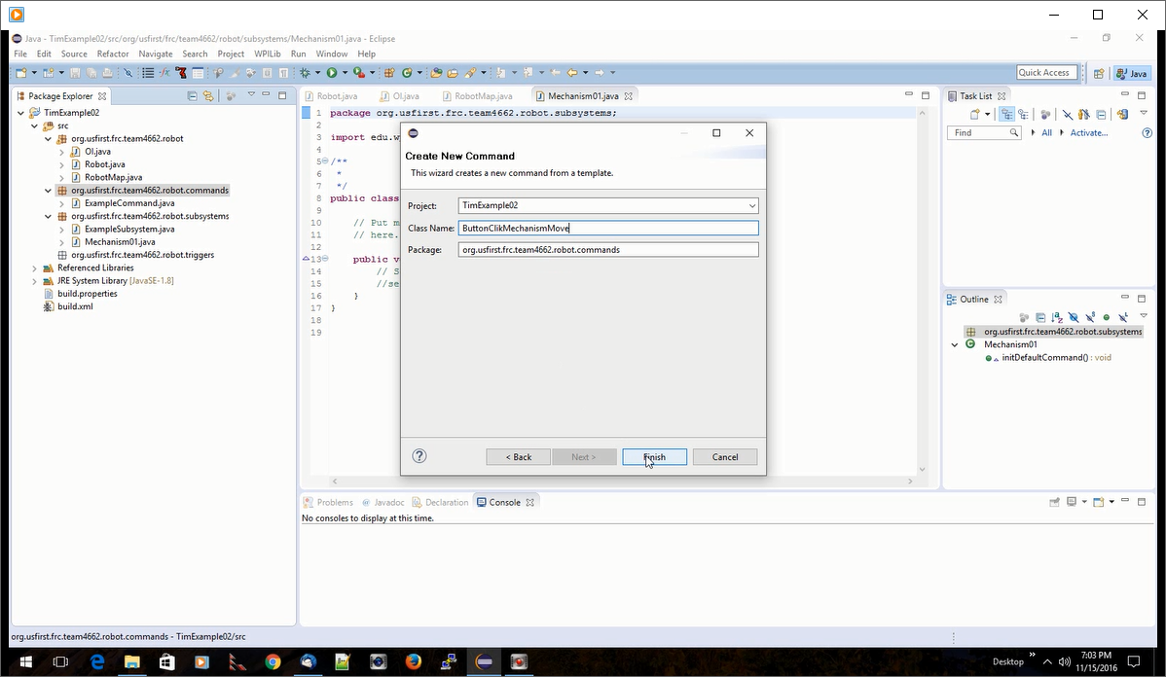
Dialog box asking for a Command name.
Naming is a subject that the team can get into discussions about. In general they need to be meaningful enough that everyone can recognize what it’s doing.

Slide 10
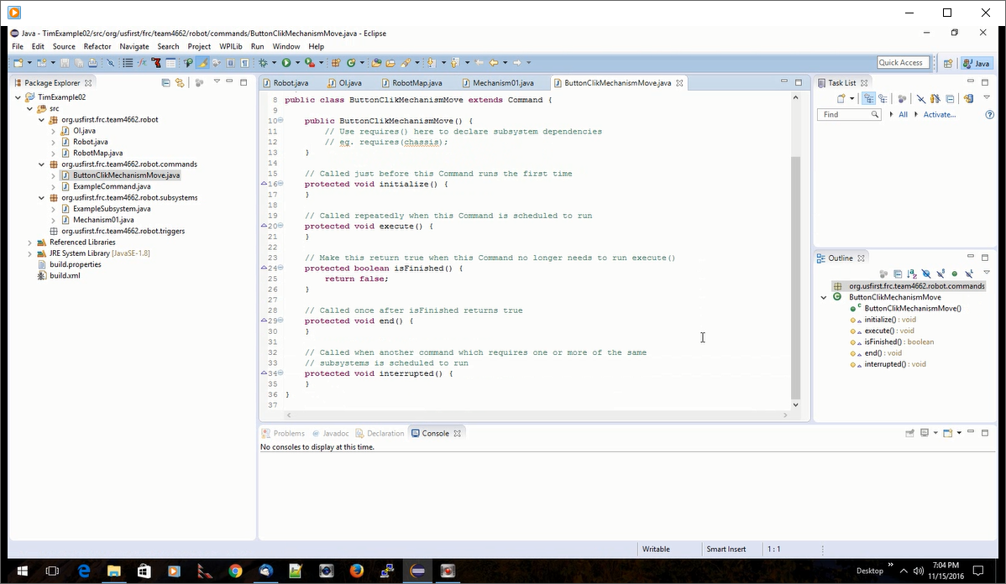
The result is all the template code with the standard methods expected within Command Based Robot as we’ve seen in previous examples.
Filling in objects and logic is left to the programming team.

